Slide 1
ERA-Net Smart Energy Systems
Standard Slide Set as of August, 2022

Slide 2
The Joint Programming Platform Smart Energy Systems
Organize the learning to enable the right technologies, market designs and customer adoption to achieve the smart energy system vision & goals of Europe
Joint Programming for Flourishing Innovation: From Local and Regional Trials towards a Transnational Knowledge Community
Goal
>30
funding partners from >25 European countries and regions
The JPP SES projects are developing close-to-market solutions and involve: companies, SMEs, research organisations, public organisations.
JPP Smart Energy Systems has received funding from the European Union’s Horizon 2020 research and innovation programme under grant agreements GA-646039-ERANet-SG-Plus, GA-775970-EN SGplusRegSys, GA-883973 EnerDigit
www.eranet-smartenergysystems.eu

Slide 3
The Transnational Joint Programming Platform for Co-creation & Promoting Energy System Innovation
SET-Plan
Knowledge Community
Transnational RDD Projects
Families of Pilots and Demo Projects
ERA-Net Smart Energy Systems
ERA-Net SES is a Research, Development and Innovation (RDI) initiative.
It calls for and awards transnational Research, Development and Demonstration (RDD) projects.
In addition, it liaises with other RDI actors to build a European Knowledge Community.
Program Owners
Funding Agencies
Joint Calls
Research Organisations
Associated
Partners

Slide 4
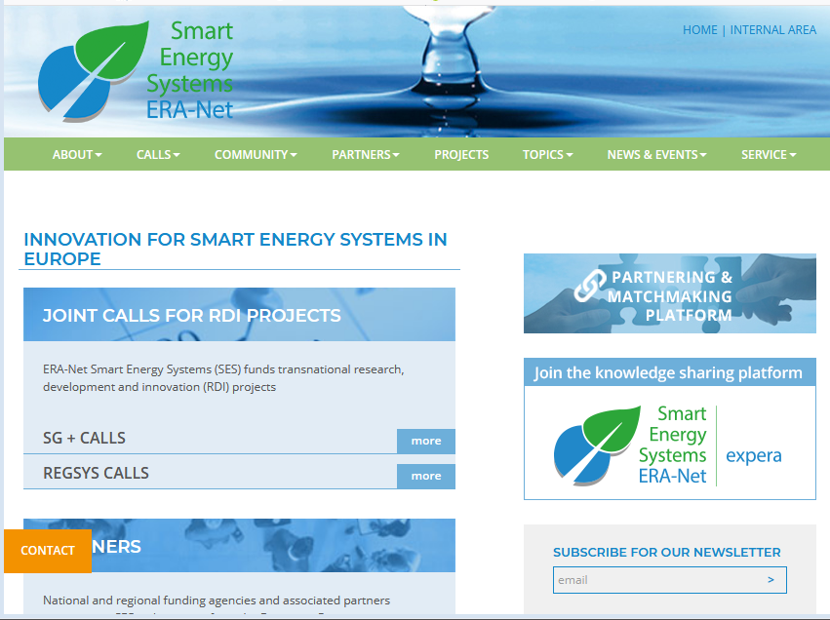
Contact the Initiative
Office ERA-Net Smart Energy Systems office@eranet-smartenergysystems.eu
Call Management callmanagement@eranet-smartenergysystems.eu
Knowledge Community knowledgecommunity@eranet-smartenergysystems.eu
Coordination
Austrian Ministry for Climate Action, Environment, Energy, Mobility, Innovation and Technology
Coordinator: Michael Hübner

Slide 5
Links and Resources
Website, Newsletter Registration | www.eranet-smartenergysystems.eu
National Contact Points | www.eranet-smartenergysystems.eu/About/Funding_Partners
News | www.eranet-smartenergysystems.eu/News_Events/News
Events | www.eranet-smartenergysystems.eu/News_Events/Events
Knowledge Sharing Platform | www.expera.smartgridsplus.eu

Slide 7
About ERA-Net Smart Energy Systems
The transnational joint programming platform (JPP) ERA-Net SES unites over 30 funding partners from European and associated countries. It functions as a network of owners and managers of national and regional public funding programs in the field of research, technical development and demonstration.
ERA-Net SES provides a sustainable and service-oriented joint programming platform to finance transnational RDD projects, developing technologies and solutions in thematic areas like smart power grids, integrated regional and local energy systems, heating and cooling networks, digital energy and smart services, etc.
www.eranet-smartenergysystems.eu

